Slide 1
Document DB (MongoDB)

Slide 2
Installation
Go to https://www.mongodb.com
Then From Product menu go to community edition.
Install Mongo DB community server edition.
From available install select current version then windows and msi file, then run it on your current windows this will install mongo db server.

Slide 3
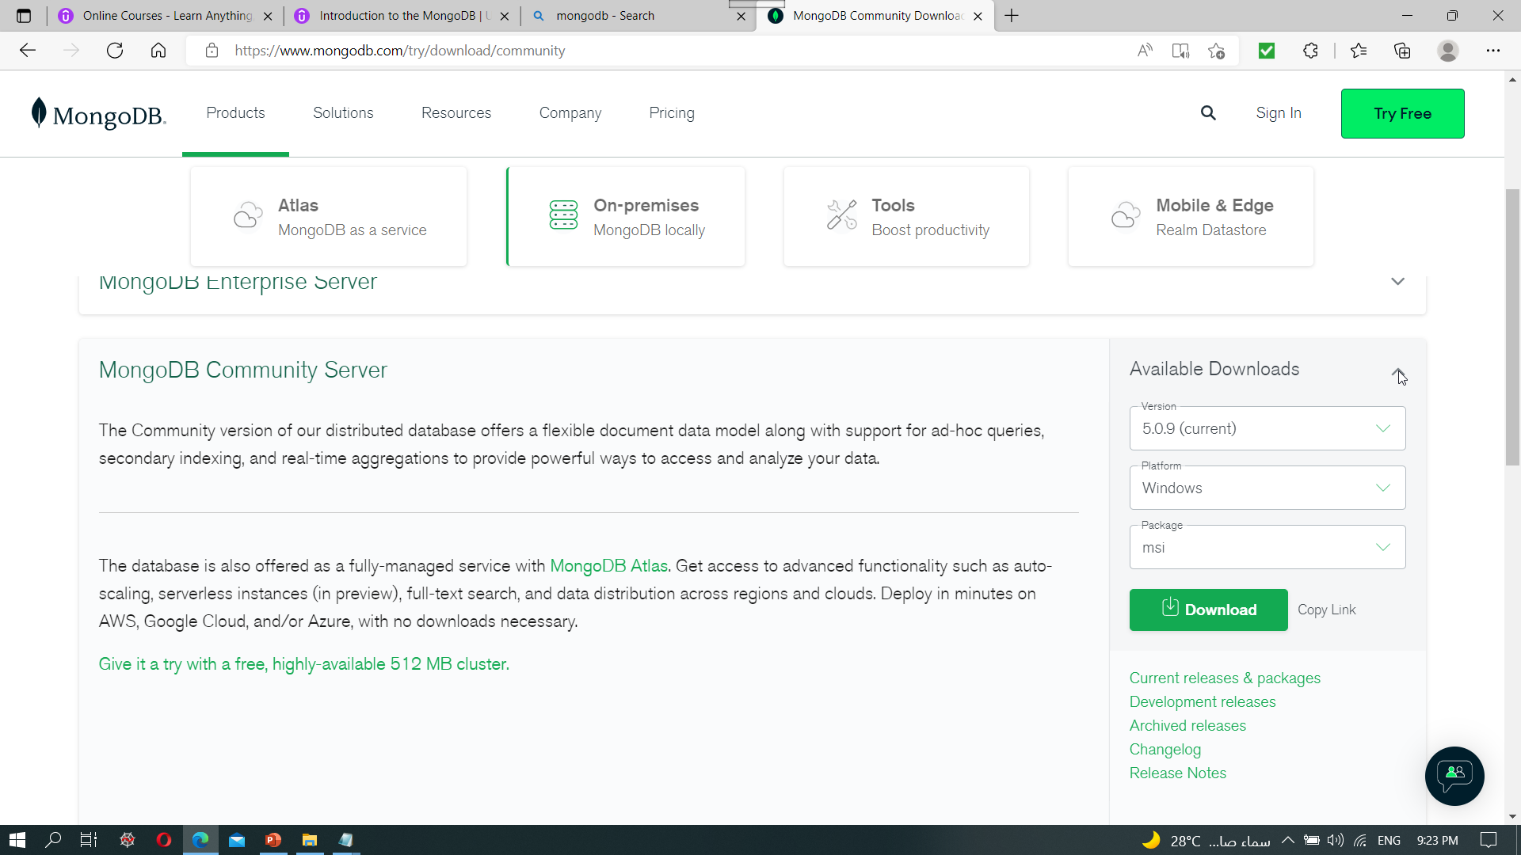
Installation

Slide 4
Installation
If you want more help then you will find every thing on
Install MongoDB Community Edition on Windows — MongoDB Manual
After that you must mongo shell to use it to connect to mongo db server ( mongsh)
Go to next link in order to install mongodb shell
MongoDB Shell Download | MongoDB
Launch mongodb server by use command prompt and write mongo
Launch shell by erite mongosh on another command prompt.

Slide 5
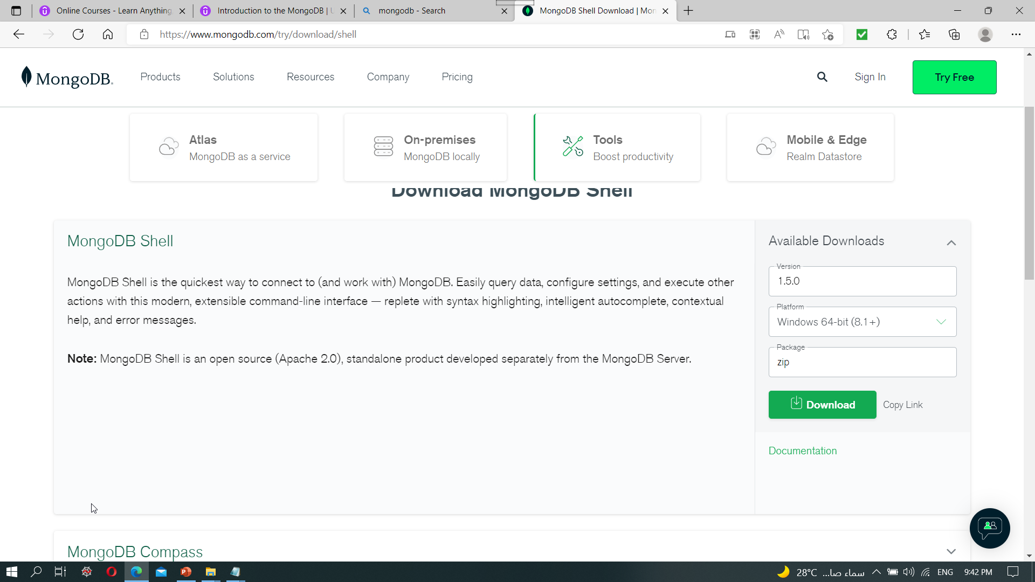
Installation

Slide 6
Installation
From your pc then properties then advanced system setting make sure to add MongoDB path to your environment variable
Like this for example C:\Program Files\MongoDB\Server\5.0\bin
From command terminal go and write mongo then enter to run MongoDB server on your local machine.
From command terminal go and write mongosh then enter to run shell to connect to server.
Test any commands inside monogsh like (db.version(),show dbs (admin , config , local) and see the result.

Slide 7
Installation
Example of shell commands in which you can take a look inside mongo databases.
> use admin
Switch to admin database ( set it as current database )
>show collections
Display collections inside admin databases.
>db.stats()
Display some statistics about databases

Slide 8
Installation (Studio 3T Free)
It is a graphical tools to manage MongoDB . It is easier than manging thought commands of mongo shell.
Go to Robo 3T | Free, open-source MongoDB GUI (formerly Robomongo) (Note previously there is two product Robo and Studio but Know both is merged together)
Click on download Studio 3T for free, then choose for windows.
Run setup file .exe on your computer . And then open Studio 3T and select shell-centric for preferred view when opening the collection.
Sign in and complete register form.

Slide 9
Studio 3T
Create new connection by manually configure my connection.
Test Connection if success click save and finish then enjoy your work through powerful GUI management tools for MongoDB server.
AS you will see by this tool you can manage your databases easily for NO SQL Document databases like what you already do with SQL management studio for SQL database.

Slide 10
Data Formats in MongoDB
The JSON syntax is derived from JavaScript object notation, but the JSON format is text only.
Example of JSON Format is:'{"name":"John", "age":30, "car":null}'
Since the format is text only, JSON data can easily be sent between computers, and used by any programming language.
When storing data, the data has to be a certain format, and regardless of where you choose to store it, text is always one of the legal formats.
JSON makes it possible to store JavaScript objects as text.

Slide 11
Data Formats in MongoDB
JavaScript has a built in function for converting JSON strings into JavaScript objects : JSON.parse()
JavaScript also has a built in function for converting an object into a JSON string : JSON.stringify()
All Documents in the mongodb is stored in BSON format which is binary BSON format so data is stored by ascii code.
JSON contains only 6 data types( String, Number, Object, Array, Boolean, NULL), but BSON contains more data types.
Extended JSON is used to represent BSON datatypes in readable format.
MongoDB Extended JSON is a string format for representing BSON documents

Slide 12
Data Formats in MongoDB
ObjectID type in extended JSON is identify document and must be unique within collection.

Slide 13
Collection Creation and Document Insertion
By use MongoDB Query language (MQL)
IN mongo shell
Use dbname
db.createCollection(“posts’’)
db.posts.insertOne({}) or insertMany([{},{},…])
Can be done easily by Studio 3T

Slide 14
Finding Documents
db.getCollection("posts").find({query})
db.getCollection("posts").find({postId:3511})
db.getCollection("posts").find({query}).limit(10)
db.getCollection("posts").find({query}).skip(2)
db.getCollection("posts").find({query}).sort(postID)

Slide 15
Update and Delete Document
db.getCollection("posts").updateOne({query},update operator($set,$unset,$inc))
db.getCollection("posts").updateMany({query},update operator($set,$unset,$inc))
db.getCollection("posts").deleteOne({query},update operator($set,$unset,$inc))
db.getCollection("posts").deleteMany({query},update operator($set,$unset,$inc))
Example:db.getCollection("posts").updateOne({postId:3511},{$set:{shared:true}})

